Slide 1
Fabric Network
Runtime Architecture
2020.12

Slide 2
Content
Architecture Overview
Roles
Relationship
Conclusion

Slide 3
Learning Advices
内容冗杂
难度颇高
思路清晰
懂得取舍
优先实践
架构
角色
角色之间的关系
角色承担的职责
履行职责时触发的事件

Slide 4
Part 1: Architecture Overview

Slide 5
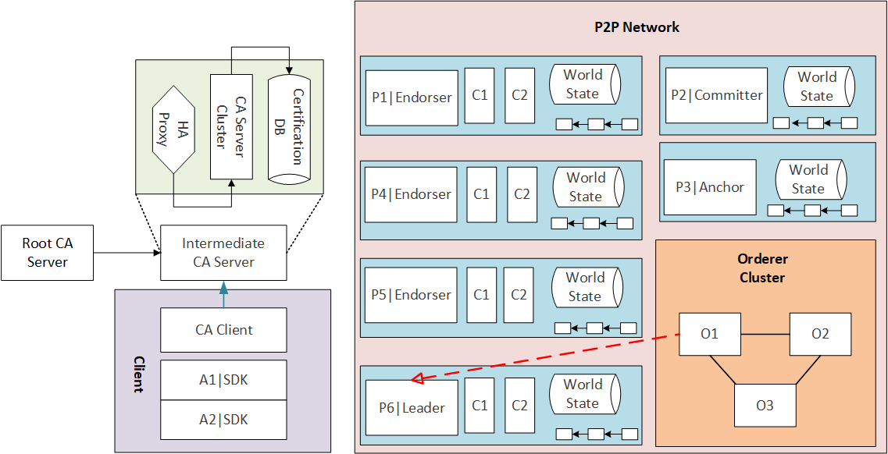
Architecture Overview

Slide 6
Part 2: Roles

Slide 7
Roles
Peer
Orderer
CA
Client

Slide 8
1. Peer
Committer
Endorser
Anchor
Leader

Slide 9
1. Peer
Endorser Proxy:
P = {AND(P1, P2), OR(P1, P2), OutOf(m, P1, P2, ..., Pn), m <= n}

Slide 10
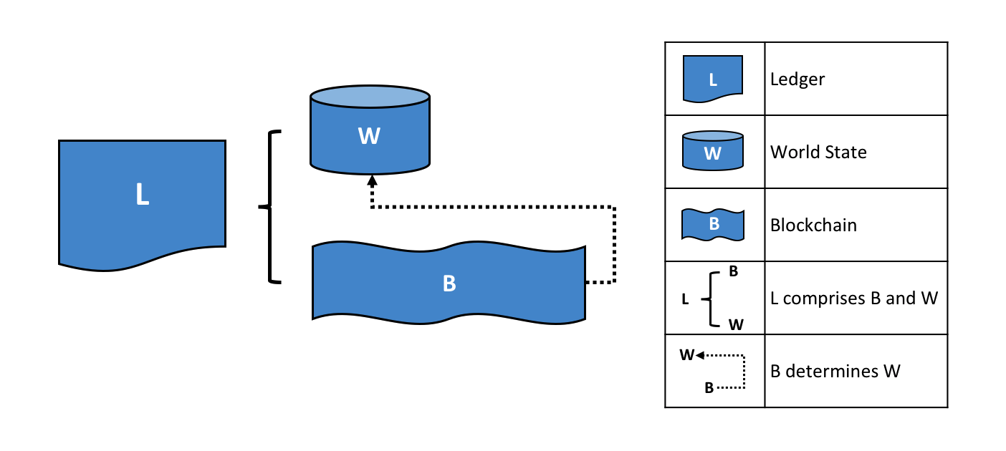
1. Peer
Chain Code
Ledger
Blockchain
World State DB

Slide 11
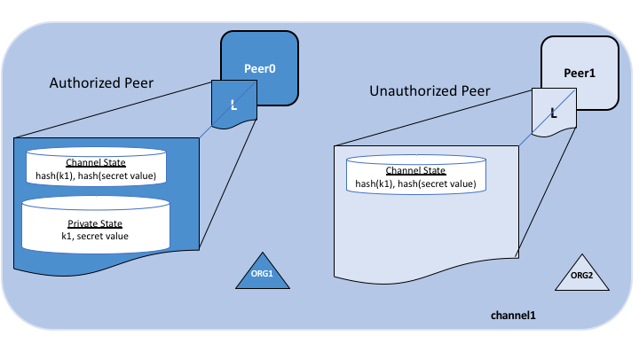
1. Peer
Gossip Protocol
Private Data
Private Block
Private DB

Slide 12
2. Orderer
What
Why
How

Slide 13
2. Orderer
Order Proxy
Solo
Kafka
Raft

Slide 14
3. CA
CA Server
Root CA
Intermediate CA
CA Client
MSP

Slide 15
4. Client
SDK
Application

Slide 16
Part 3: Relationship

Slide 17
Relationship
Channel
Organization
Cluster

Slide 18
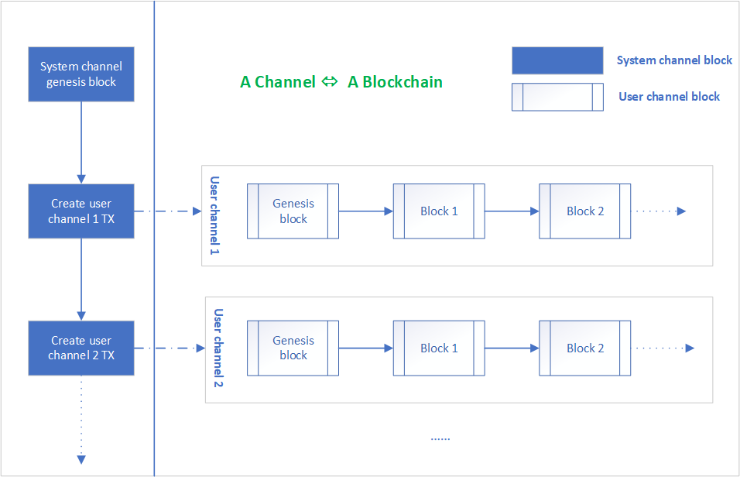
1. Channel

Slide 19
2. Organization

Slide 20
3. Cluster

Slide 21
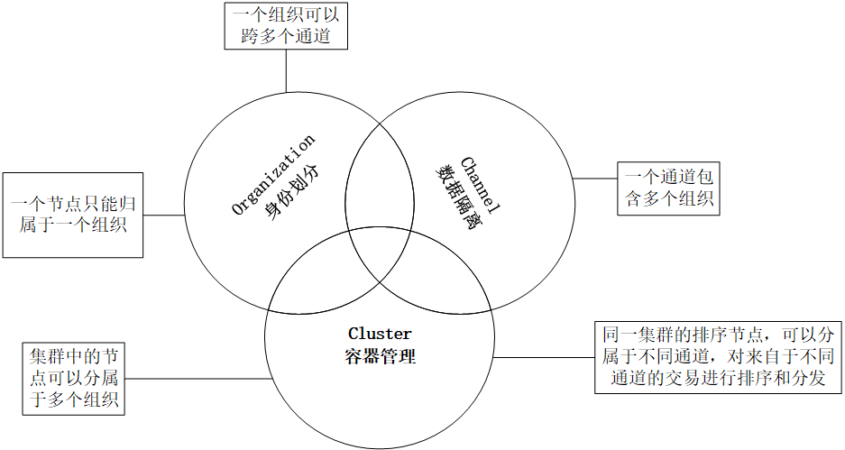

Slide 22
Part 4: Conclusion

Slide 23
Thank you

